Slide 1
CovidSIMVL
September 16, 2020

Slide 2
Agent-Based Simulation
Model complex interactions based on rules
PRIMARY level – rules for viral temporal growth dynamics within person– Xi, He et al
SECONDARY level – rules for interactions between persons affected by the virus
TERTIARY level – rules for interaction between populations moving in interacting spaces
GOAL: TO UNDERSTAND OVERALL SYSTEM BEHAVIOR

Slide 3
“Temporal dynamics in viral shedding and transmissibility of COVID-19”
Nature Medicine 15April 2020. Xi He, Eric HY Lau et al.
Susceptible
Incubating
Pre-symptomatic
Symptomatic
INERT
Infected
INFECTIOUS
onset
critical
Peak Viral Load
?? Approach
Use susc?
serious
4.3d
mild
T=0
2.9d
5.2d
20d
T=0 to 5.2d use 1.15 as compound rate of increase of VL (from 1 to 100)
T=5.2 to 20d use 0.75 as compound rate to go from VL=100 to 1
Stochastic example: VL -> B at 2.9*Math.random(0.29)
if (Math.random(2) > 1) { VL = -VL}

Slide 4
Primary Level
Uninfected – susceptible
Incubating
Asymptomatic infectious
Symptomatic or Positive Test
Removed from circulating population

Slide 5
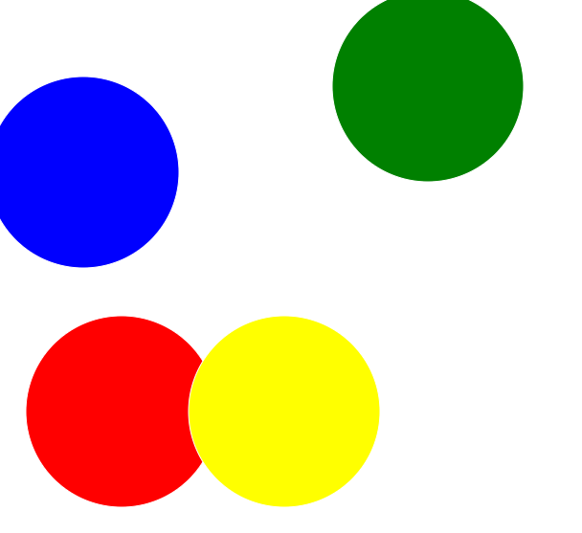
SECONDARY Level
Fixed Space – population density
Mingling – if none, no touch
Size – the larger the more susceptible
– the larger the more infections
The primary and secondary level PARAMETERS determine
- course of an epidemic
- the duration and intensity of spread
- within a single space

Slide 6
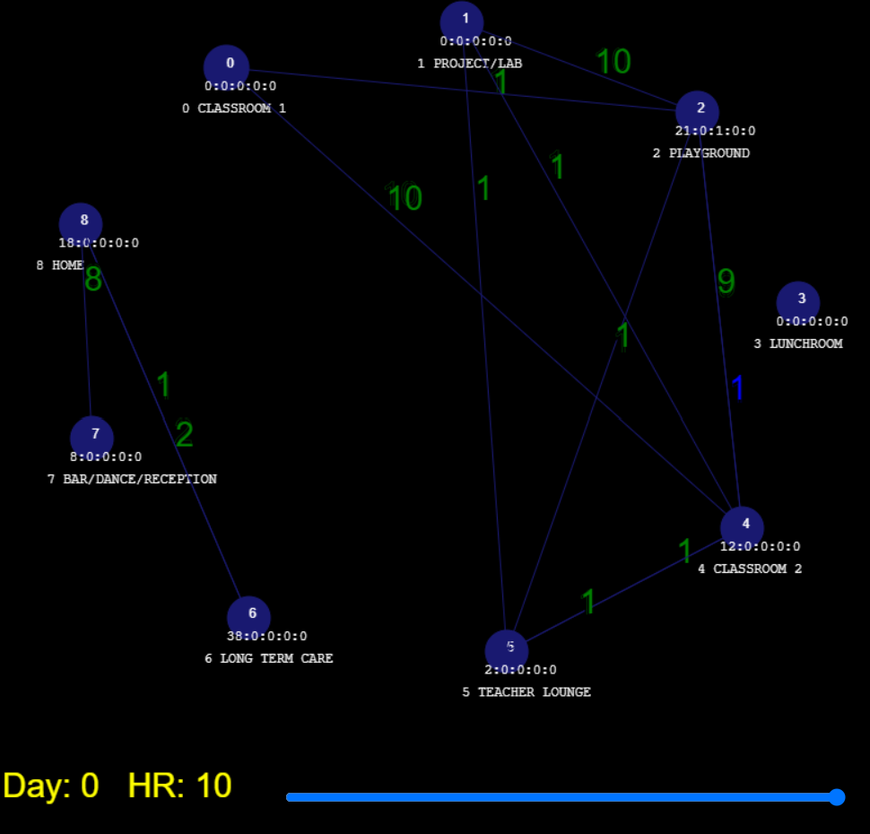
TERTIARY Level

Slide 7
SHOW FIXED UNIVERSE

Slide 8
School-home-LTC-bar
100 persons
3 x 10 groups of students – 6 teachers
2 classrooms, project room, playground, lunch, teacher lounge
LTC with 28 residents + 14 staff in 3 shifts
High-mingle (bar) – 10 staff 10-23hrs
6 grandparents, 5 spouses
19 family groups – multi-generational, single parent etc
24-hr schedule repeated daily

Slide 9
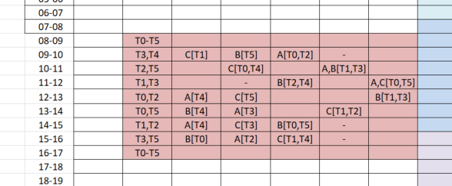
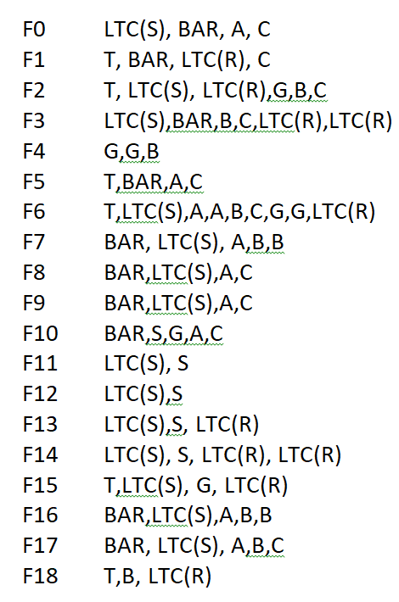
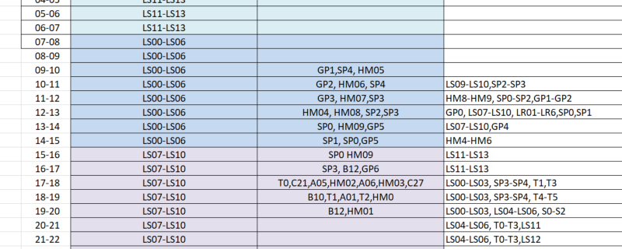

Slide 10
SHOW SCENARIO SCHOOL-HOME-LTC-BAR

Slide 11
What System Metrics?
Time to first new infection
Time to first infection in LTC
Time to 10% - 20% - 30% - 40% - 50% of population infected
Which Universes host the most infections - ranked
Which persons are super-spreaders if any
What is the distribution of length of chains of infection?
How do parameter value changes affect system behaviours?
How to use as tool to quantify and modify risk?

Slide 12
CALIBRATION and Simulate
Determine combination of parameters that will lead to:
N infections per hour (or day or week)
Set parameters for each Universe at acceptable or minimal levels
Run trials to find overall behavior given these local settings
Modify local settings to obtain better system behavior

Slide 13
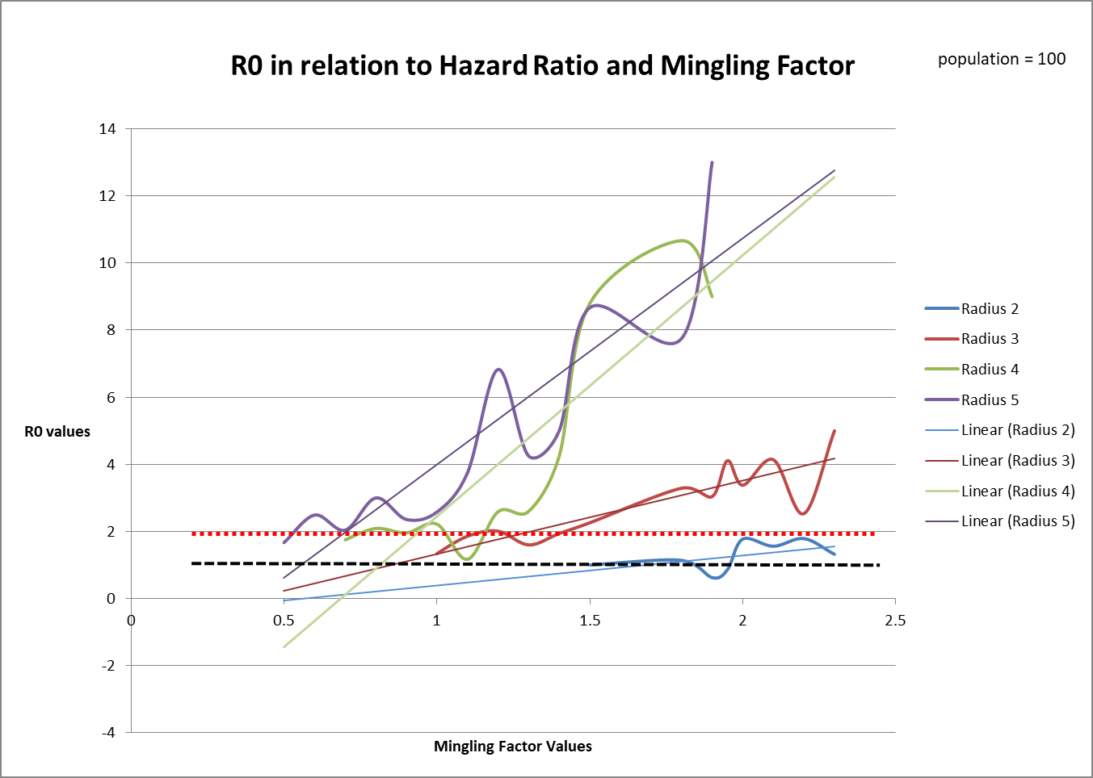
TRIALS
R0 < 1 certain extinction
R0 > 2 expanding epidemic
This family of curves for
Hazard Radius gives
MingleFactor values for R0’s
Each size has a different
starting point for sustained
epidemics

Slide 14
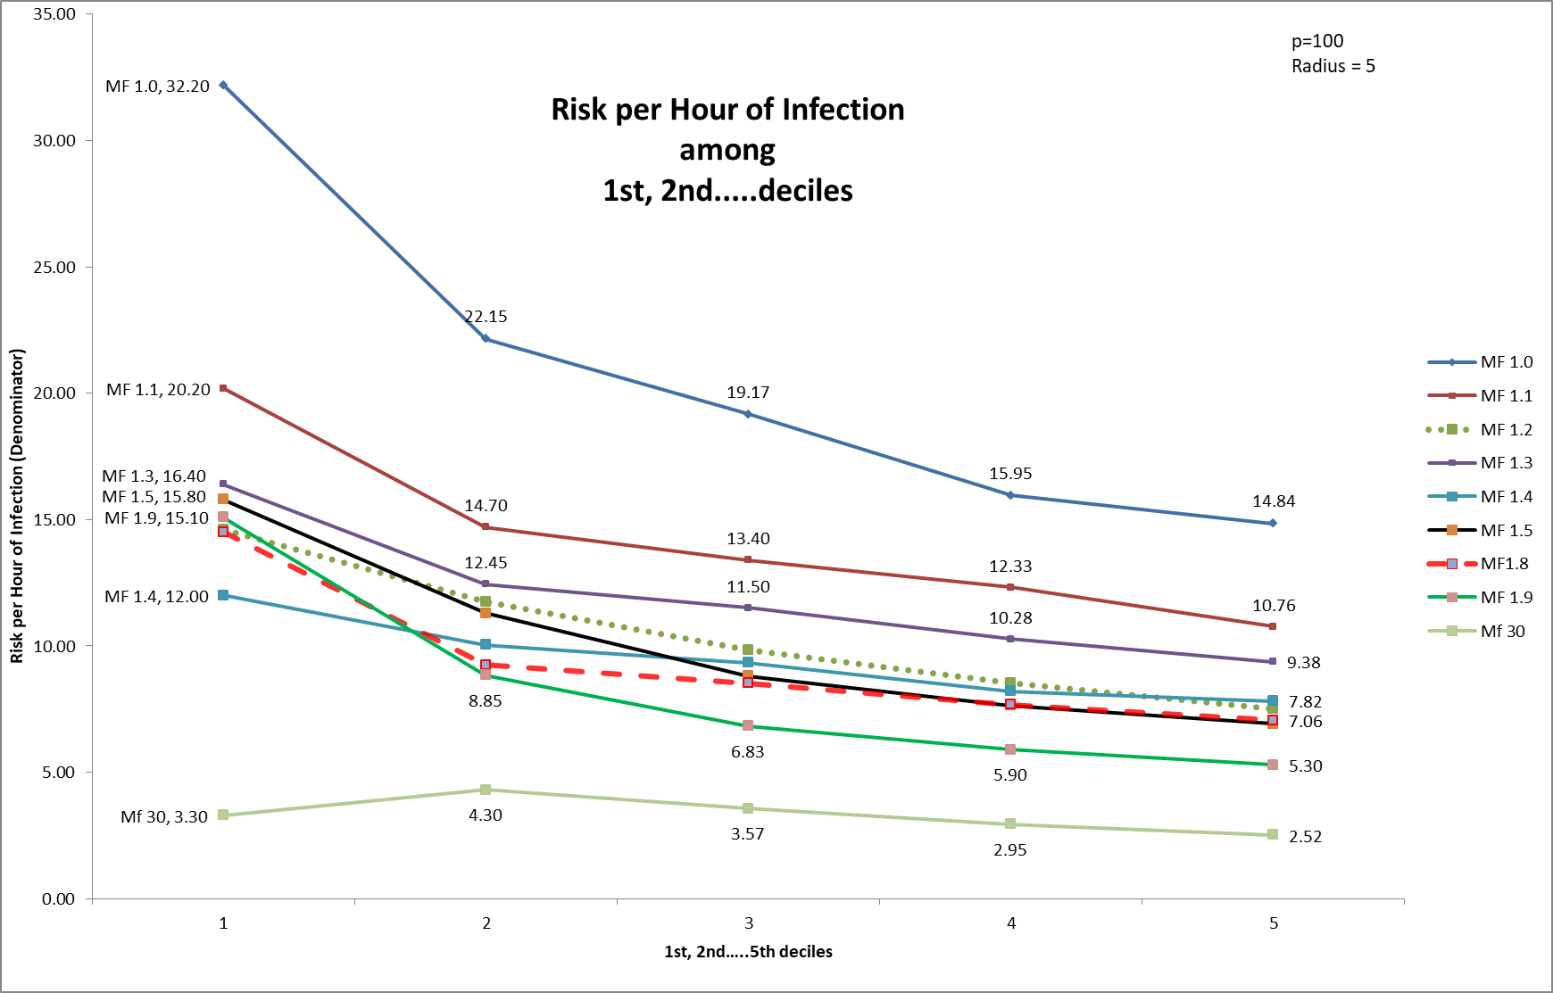
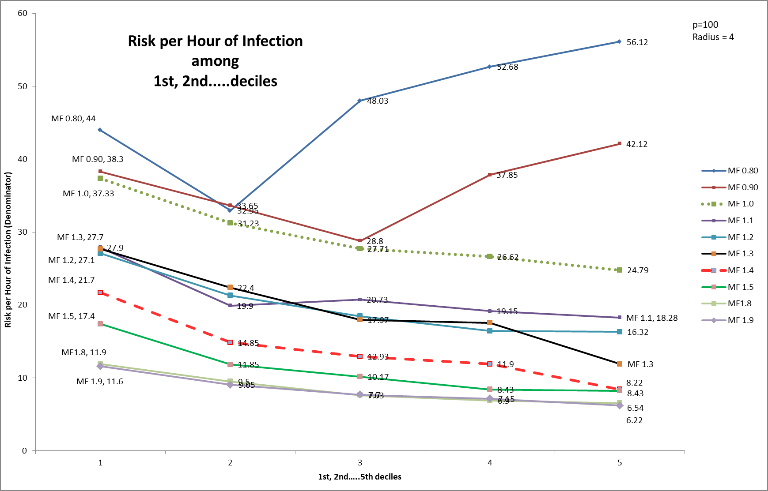
If the first 10 new infections takes
200 generations (hours), then
each 1 infection in this period
Is 10/200 or 1/20 = Risk per hour
Denominator show integer values.
Smaller RPH (20) => greater risk
“1 in 20” or “1 in 3”
The top graphs are for radius=5
The bottom for radius=4
If the slope decreases, the values
are smaller with each decile
(hrs to 10, to 20, to 30…infections)
More infective
Rising means taking longer to
find next infection
RPH 60 = 60 consecutive hrs or
10 school days to an infection

Slide 15
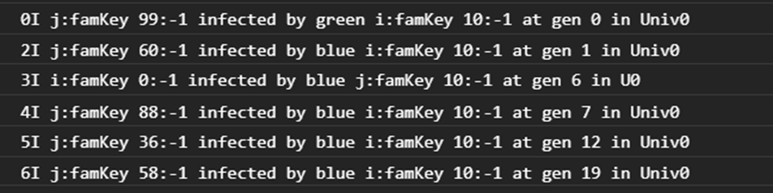
Chains of Transmission
From this log, we can derive who infected whom and when
10 → 30 → 55 → 41 → 59 → 0
From these chains, we can find:
- the distribution of lengths (and how they change over time)
- the distribution of infective power (super-spreaders)
If contact tracing is seen as a sampling into length and frequency of
Chains of Transmission, then we can estimate what distributions they
Match, and therefore the actual (latent) size of the infected population

Slide 16
What next?
Open source public domain tool
Part of Michael Smith Covid-19 Research Grant
Collaborate on process to determine usefulness in existing and emerging pandemic problem sets
Help quantify and optimize approaches to prevention, mitigation and control (eg specific effects of more intense testing policy)
Need data for population movement (not role level but at group or cluster level) eg for homeless, for mental health, for inter-city travel

Slide 17
Implications of R0 and RPH
For a specific Universe, you can design the radius and mingle factors to yield specific RPH (and R0)
You can combine these Universes in CovdiSIMVL to identify those Universes that are “hottest” in new infections given the movement patterns of populations
You can change a factor in a Universe (say increase mitigation and therefore decrease the Mingle Factor by some percentage) and observe
The changes in the Universe
The changes in the overall system dynamics
Essentially, you can run synthetic epidemics that you have designed with different scenarious

